Slide 1
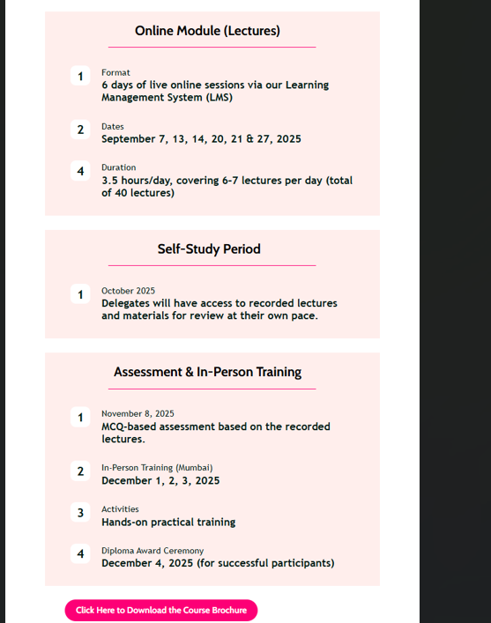
Use icons related to topics instead of numbers to make it more appealing

Slide 2

Remove join now

